Slide 1
Self-Determination & Self-Advocacy
Learning Objectives:
Students can communicate information about their interests, needs or rights.
Students can demonstrate the skills needed to make choices based on interests, needs or rights.

Slide 2
Self-Determination & Self Advocacy:
“Dignity of Risk” by Chris Lyons
“I want you to imagine that you live in a world where I am the boss of you….”
Kick-off Activity

Slide 3
Self-Determination & Self Advocacy:
“Dignity of Risk” by Chris Lyons
Discussion Questions:
Scenario 1: Recall the first scenario where I am the sole boss of you. You voice what you want to do, but I make all of the decisions and accompany you everywhere you go.
How does this first scenario make you feel?
Would it be easy, or difficult, to have me in the ‘driver’s seat’ of your life? Why?
Describe the negative impact(s) of this scenario.
Scenario 2: In the second scenario, you still have to ask my permission and continue to check in with me, but I no longer accompany you on the bus or at your friend’s home. Depending on how well you perform, I can take away privileges at any moment.
How do you feel now that you have a little more choice in hanging out with friends?
How does hanging out with friends become more meaningful?
Is this scenario more comfortable, or less comfortable, for you? Why?
Classroom Activity

Slide 4
Self-Determination & Self Advocacy:
“Dignity of Risk” by Chris Lyons
Discussion Questions:
Scenario 3: Here, I am still the boss, but you no longer have to ask permission. However, if you make the wrong choice, or encounter a natural consequence based on your actions, I share responsibility.
How does this scenario make you feel?
What is the negative impact of having problems (or consequences of your actions) fall on your boss?
Scenario 4: In this final scenario, I am no longer the boss of you. You make all of your decisions and take responsibilities for any natural consequences based on your actions.
How does it feel to be fully responsible in making choices based on your needs and wants?
Why is it important to be responsible for your own actions and failures?
Classroom Activity

Slide 5
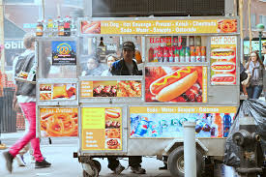
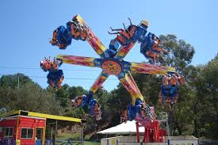
Self-Determination & Self Advocacy:
Discussion Extension:
Use the following images to explore different levels of choice making around needs and wants, potential consequences, and steps one can take to prevent or problem solve roadblocks.
Classroom Activity

Slide 6
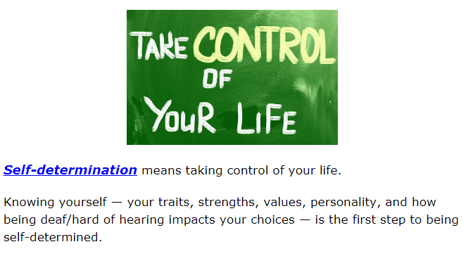
Map It Online Activity:
Share a personal experience related to self-determination.
How is Steven self-determined? How does he self-advocate?
What is the first step to becoming self-determined?
Self Determination

Slide 7
Self-Determination & Self Advocacy:
Steps for decision making include: assessing options and the positive and negative consequences, executing a plan, and reflecting on outcomes.
Examine the different problems on the Decision Making Scenario handout and analyze possible solutions.
Listen to each problem, and with your group, evaluate the different options.
Work with your group to decide the best decision for the problem.
Share your decision and reasoning with peers.
Decision Making Activity

Slide 8
Map It Online Activity:
What is the difference between self-determination and self-advocacy?
What does it mean to ‘stick up’ for yourself? Does anyone want to share a personal experience?
Give an example of what it means to be self-determined.
Give an example of what it means to self-advocate.
How does knowing about yourself help you self-advocate your needs and rights?
Self-Determination vs. Self-Advocacy

Slide 9
Self-Determination & Self Advocacy:
Set two or three self-advocacy or self-determination goals for the school year. Goals should related to:
choice making, goal setting/attainment, self-advocacy, problem-solving, self-awareness, person-centered planning for an IEP, self-evaluation, interpersonal relationships, or self-initiation.
Examples include:
I will use a problem solving strategy to determine the best solution when hitting a roadblock.
I will make choices based on my needs, preferences and interests.
I will communicate my needs and request needed accommodation(s) during my work-based learning experience.
Synthesis Activity- Goal Setting

Slide 10
Self-Determination & Self Advocacy:
Exit Ticket
Give an example of a personal choice you have made (or would like to make) based on your interests, skills, or goals.
Share an “I will….” statement related to setting a self-determination or self-advocacy goal for the year.

